Slide 1
Project 1: Tickets

Slide 2
Class Ticket
Write a definition for class Ticket.
A Ticket object corresponds to a physical ticket for a stage show.
Attributes of a Ticket are:
Name of Show
Name of Venue
Date (3 integers, Month, Day, Year)
Time (2 integers, hour (0..23), minute (0..59)
Seat
Row Name
Seat Number (A positive integer)

Slide 3
Class Ticket
Define structs to represent date/time and seat.
Put the struct definitions in Ticket.h prior to the class definition.
Let the constructor take four parameters:
Show_Name
Venue_Name
When (Date and Time)
Seat (Row Name and Seat Number)

Slide 4
A Changeable Attribute
Let each ticket have a Boolean attribute called "sold"
Initially false.
Member function Sell() sets sold to true.
Note: bool is a type in C++.

Slide 5
Display()
Public member function Display() outputs all attribute values to the console.
See sample run for format.
Make your output match the sample run.

Slide 6
Accessor Methods
Provide an accessor method for each attribute:
Venue_Name
Show_Name
When
Seat
Sold

Slide 7
Main Program
Write a program to test the class definition.
The main program:
Gets attributes for a ticket from the user.
Dynamically creates a Ticket object with the specified attributes.
Calls the ticket's Display() method.
Gets the attributes of the Ticket object with the accessor methods and shows them in the same format as the Display method.
Sells the ticket.
Calls the ticket's Display() method again.
Deletes the ticket.

Slide 8
Main Program
Exit after creating and displaying one Ticket.
Input validity checking is not required.
Assume user inputs valid values for all parameters.
OK to fail on invalid input.

Slide 9
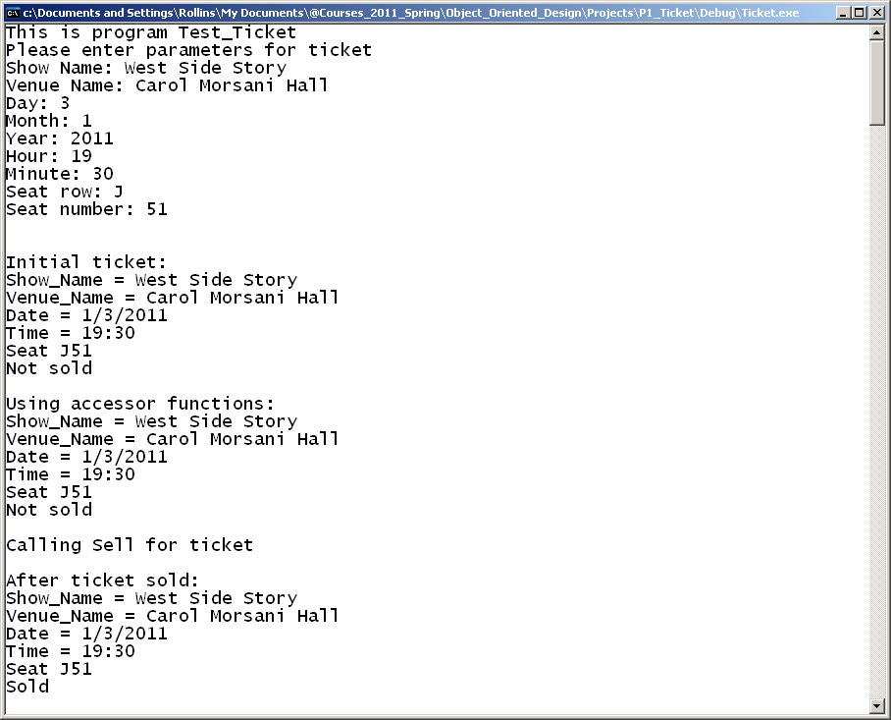
Sample Run -- Windows

Slide 10
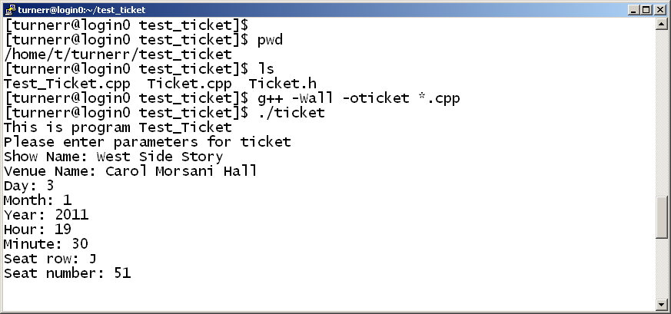
Sample Run -- Linux
Continued on next slide

Slide 11
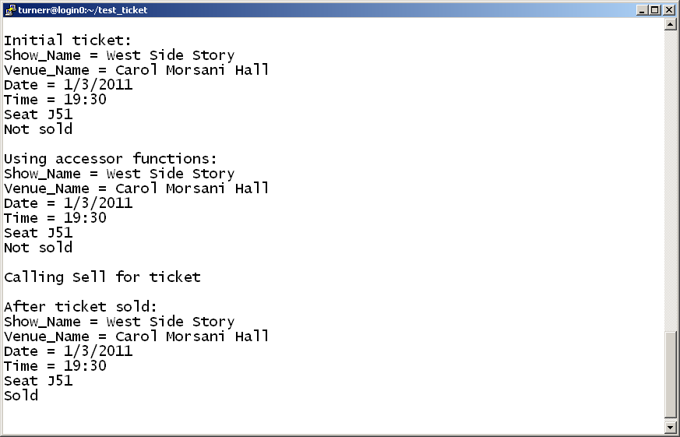
Sample Run -- Linux (continued)

Slide 12
Implementation Tips
Read about I/O manipulators.
Textbook page 1091
Header file iomanip
Specific manipulators:
setfill( )
setw( )

Slide 13
Development Environment
You may develop your program on any system you like.
But you should test the finished program on Circe.
The same source file should compile and run on either Windows or Linux.

Slide 14
Ground Rules
You may work with one other person.
OK to work alone if you prefer.
If you do work as a pair
Work together!
Both members are expected to contribute.
Submit a single program.
Both members should understand work in detail.
Do not share your code with other students.
Before or after submitting the project.
It is OK to discuss the project.
Do not copy any other student’s work.
Don’t look at anyone else’s code
Don’t let anyone look at your code.

Slide 15
Ground Rules
Except for code posted on the class web site
Do not copy code from the Internet
or any other source.
Do not ask for help on an Internet forum.
Write your own code.

Slide 16
Submission
Project is due by 11:59 PM, Thursday, Jan 28.
Deliverables:
Source code only.
Three files: Test_Ticket.cpp (Main Program),
Ticket.h, Ticket.cpp
Zip the files and submit the .zip file
Submit the files using the Canvas Assignment for this class.
If you work with another student, include both names in the assignment comments.
One student submits the files
Other student should submit just a Canvas submission comment including both names.
End of Presentation

